Slide 1


Santosh Kumar Kar,
skkar.2k2@gmail.com

Slide 2
CHAPTER – 8
Spring Boot – Web MVC

Slide 3
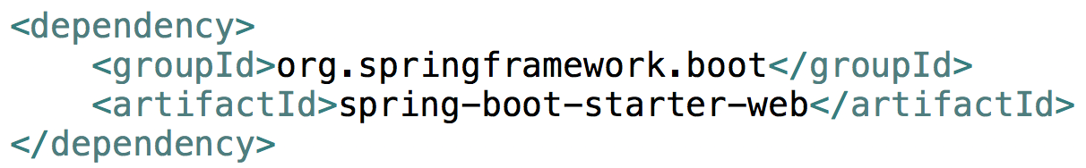

To enable support for JSP’s, add tomcat-embed-jasper dependency manually
<dependency>
<groupId>org.apache.tomcat.embed</groupId>
<artifactId>tomcat-embed-jasper</artifactId>
</dependency>
To enable JSTL, add jstl dependency manually
<dependency>
<groupId>javax.servlet</groupId>
<artifactId>jstl</artifactId>
</dependency>

Slide 4
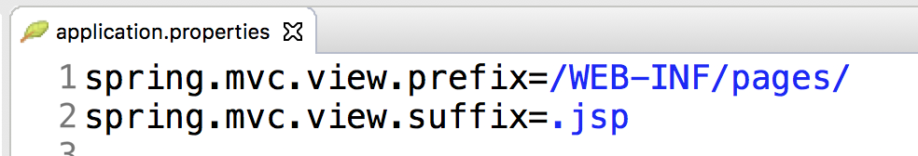
In application.properties
Configure the Spring MVC

Slide 5
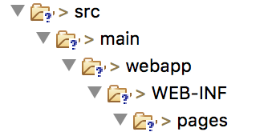
Directory path to store JSP
Create the directory path (as mentioned) to store the jsp pages that matches the application.properties cofiguration.
In src/main
src/main/webapp/WEB-INF/pages
Place all your .jsp files here in the pages
*.jsp

Slide 6

Questions
Send to skkar.2k2@gmail.com

